Slide 1
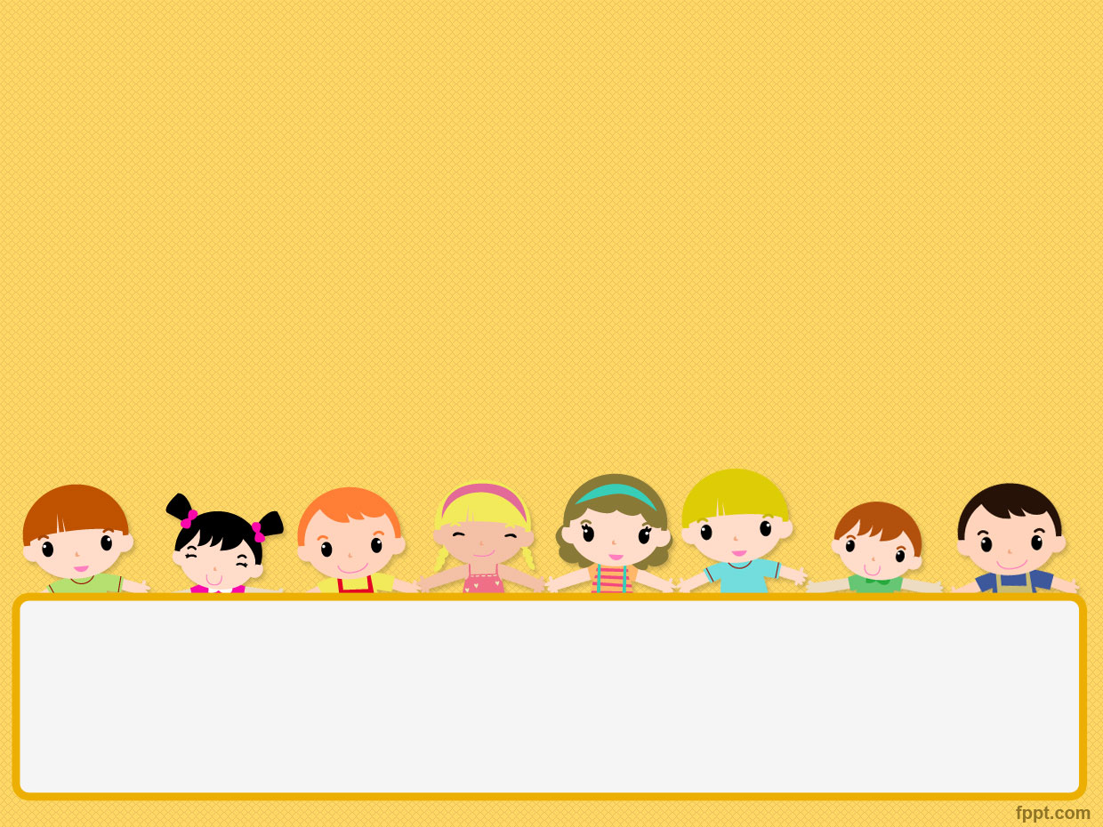
Our A.I. Age (Artificial Intelligence) --Luo Yanzhen

Slide 2
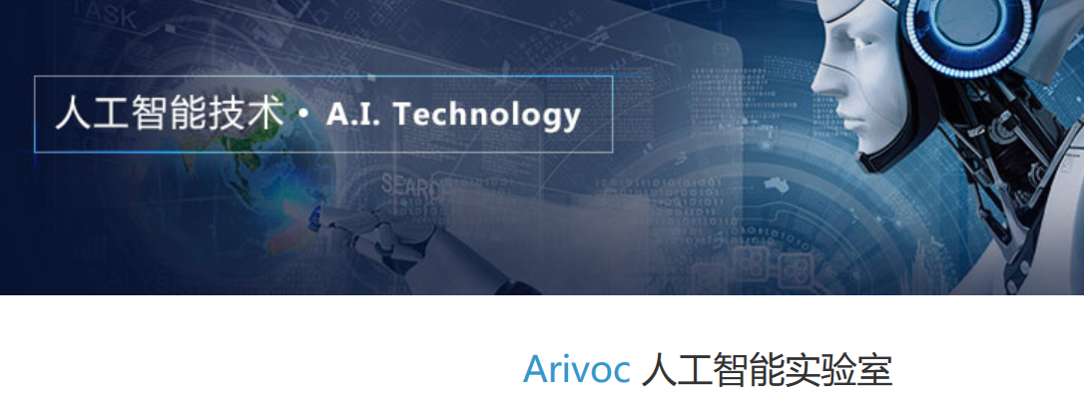
What is A.I.?
Is it still new?
It will impact us all ? !

Slide 3
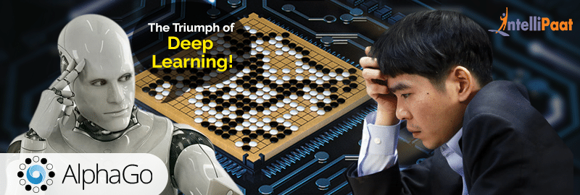
2016 Alphago beats lee sedol

Slide 4
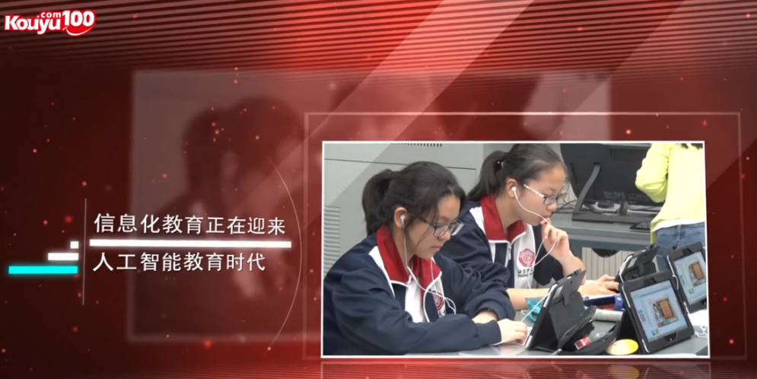
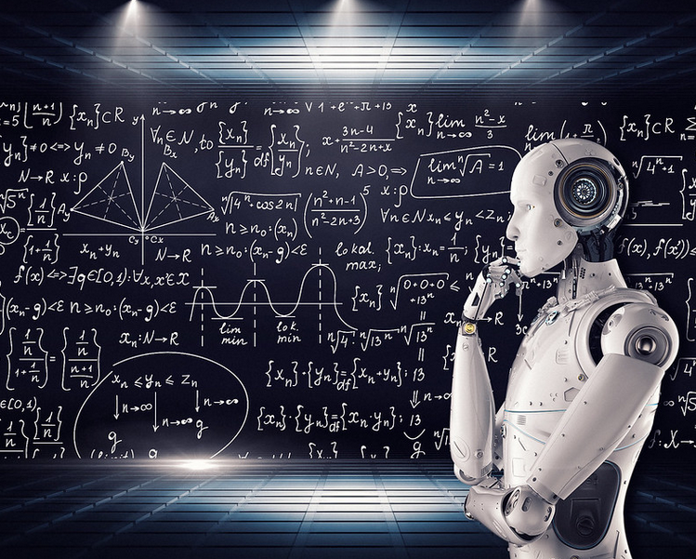
Such as “Kouyu 100”

Slide 5
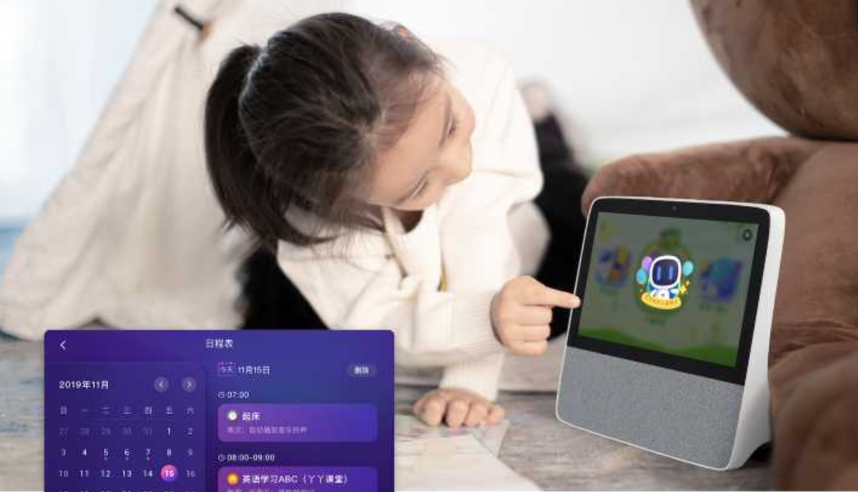
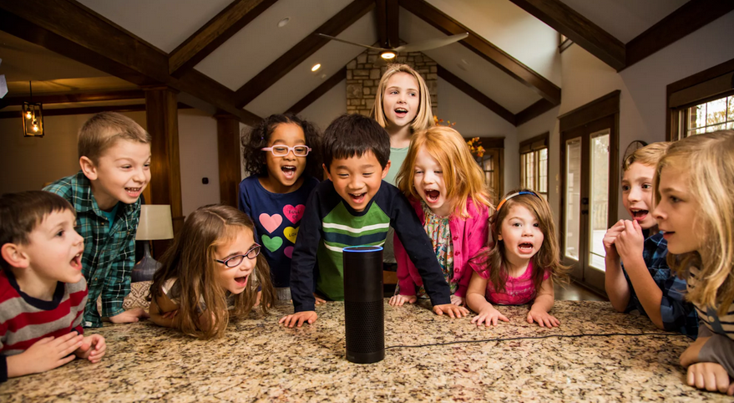
A.I. Speaker
小度，小度！
Alexa

Slide 6
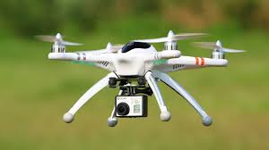
Drone

Slide 7
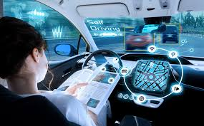
Self Driving

Slide 8
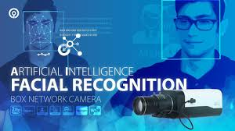
Facial Recognition

Slide 9
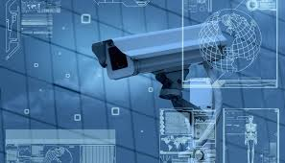
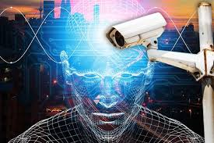
Camera System

Slide 10

e-Pay

Slide 11
What’s the next?

